Slide 1

Document Classifier
Aviral Jain | 18-May-2022

Slide 2



PROBLEM STATEMENT
Build a Document Classifier that can classify the MVP categories

Slide 3






MVP? Most Valuable Papers.
Abstract
Response To Reviewer Comments
Research/Journal Paper
Max. Traffic
Max. Revenue

Slide 4

Document Classification will lead to two prong benefits
Reducing External Dependency
Reducing reliance on client’s input thus making process more efficient
competitive advantage
Edge over competitors and greater customer satisfaction
1
Resource Optimization
Faster results will lead to savings on manhours and better overall resource allocation
2
3
Dynamic Pricing
pricing as per the doc type
3
2
Enriching Search Results
Enriching search results of R discovery and high-quality input to IDAN and hubble or paperpal
1
Future Proofing
50000 docs/day

Slide 5
How we progressed…
Introduction
Rule Based
ML
DL
Deployment
About Cactus
Downstream Application
Roadmap
Reading documents
Point of Differentiation
Rule based Model
Reading literature
Applying common classifier
Fine-tuning
MLP
Conv 1D
PyTorch
Front end app
AWS Deployment
‘Playground’ (WIP)
ITERATIVE PROCESS

Slide 6
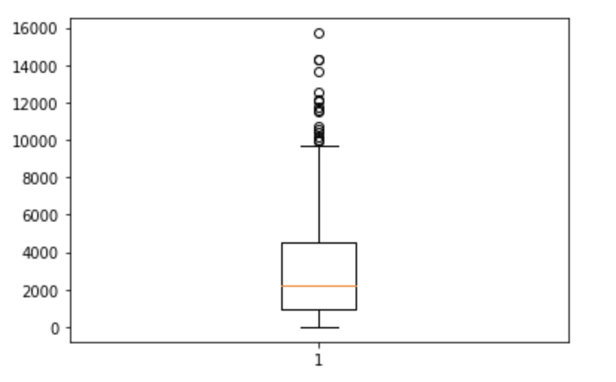
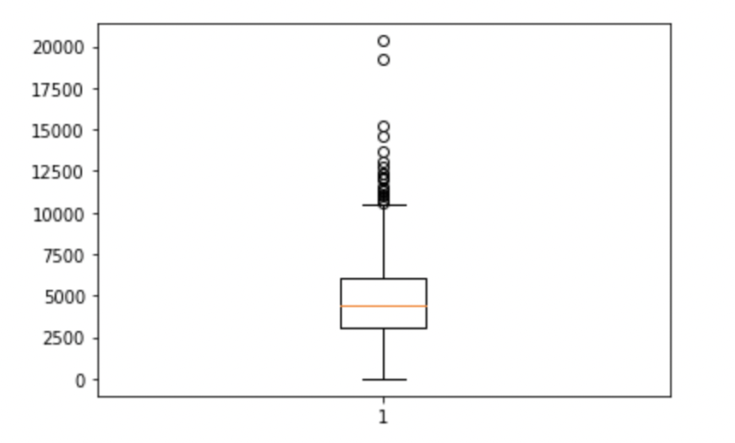
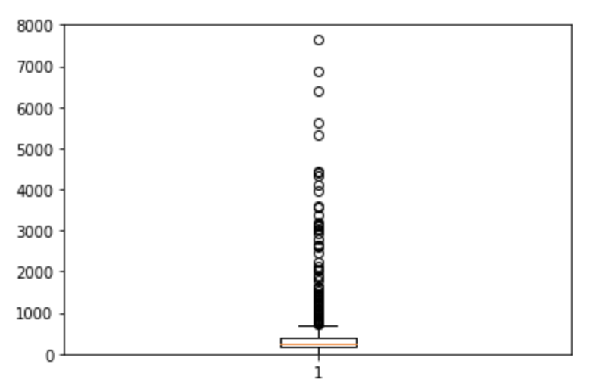
EDA (1/3)
Word Count Analysis
RTRC
Research Paper
Abstract
Word_Count
Boxplot to eliminate outliers in word count
*Removing outlier

Slide 7
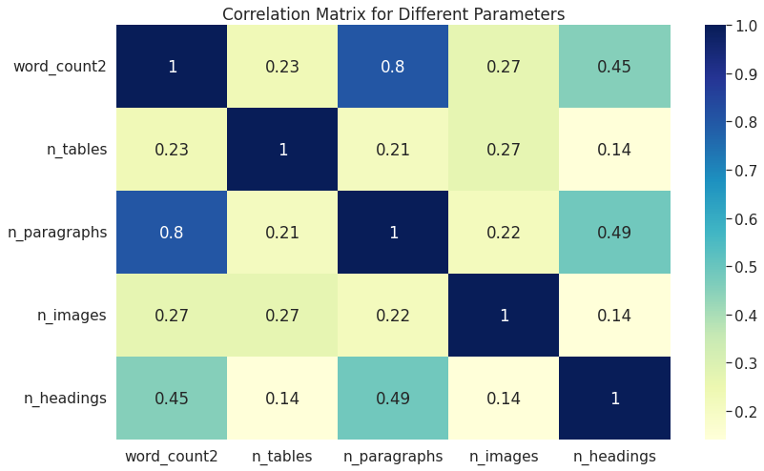
EDA (2/3)
Correlation amongst features
*Removing outlier

Slide 8
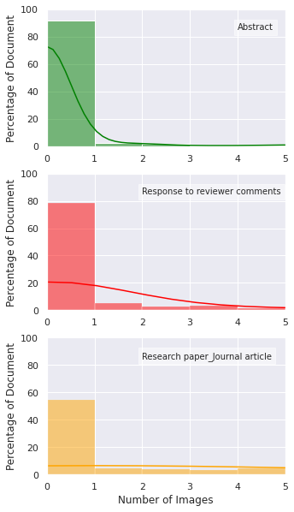
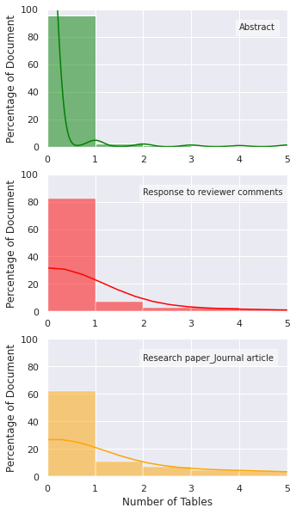
EDA (3/3)
Images and Tables
Images
Tables
 | Abstract | Research Papers | Response to Reviewer Comments
Average Image Count | ~2 | ~6 | ~1
 | Abstract | Research Papers | Response to Reviewer Comments
Average Table Count | <1 | ~2 | ~1
*Removing outlier

Slide 9
Rule - Based
Task: Find Unique Identifiers pertaining to each document
Rules
1
Doc_Type | # Para | Word Count
Abstract | 7 | 400-700
RTRC | 41 | 7k-10k
RP | 27 | 7k-10k
W = 1 if Keywords
if word_count<=1500* and w!=1:
Abstract
Filter 1
if word_count>=2500* and w!=1:
RP
if word_count>=2500 and w==1:
Filter 2
2
RTRC Keywords:
“Thank You” ,
“Comments”,
“Editor” , “Reviewer”
RTRC
*Removing outlier

Slide 10
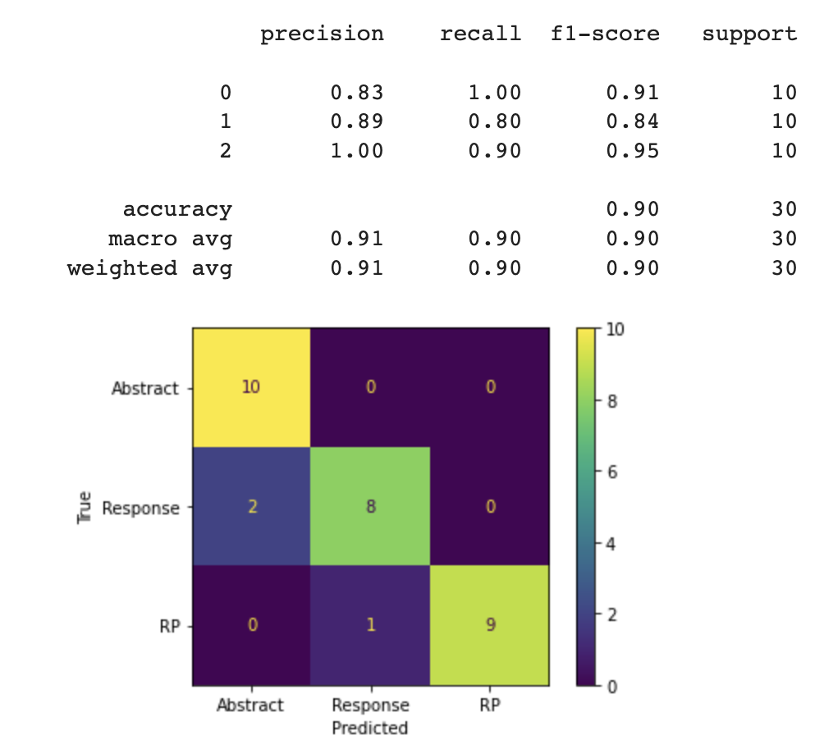
Rule - Based
S.No. | Model Rules | Acc% | Comments/
1 | RTRC: 2500-3500 | 48% | RTRC were misclassified
 | RP: 3500+
2 | Abstract <1500 | 67% | Word count of RTRC were very diversified
 | RP: 2500+
3 | Abstract<1500 | 90% | Word count coupled with unique phrases
 | RP>2000
 | and does not contain “reviewer”, “editor”,”thank you”
Slow and Non-Scalable !
*Removing outlier

Slide 11
ML – Classifiers
The Most popular way of feeding text to a machine is TFIDF
Converting the document in TFIDF vectors and feeding them into classifiers
Train | MVP | MVP | MVP + others
Test |  | MVP JSON files
Model Name | Accuracy | Accuracy | Accuracy
SVM | 92.98% | 92.98% | 80.23%
Random Forest | 91.22% | 91.23% | 84.88%
XG Boost | 91.22% | 89.47% | 79.06%
Ada Boost | 87.17% | 87.72% | 66.27%
Naive Bayes | 71.92% | 70.01% | -
KNN | 49.12% | 51.21% | -
Fast, Stable, Scalable !

Slide 12
Including "Other" Categories in Dataset
Strategy:
Sample 700 samples from Remaining classes and add them to the dataset
Label them as "Other
Run Experiment Again
​ | Accuracy​ | Precision​ |  |  |  | Infer Time (ms)​ | Feature vec Size​
​ |  | Abstract​ | RTRC​ | RP​ | Others​
Before Adding​ | 92 | 1​ | 0.83​ | 1​ | -​ | 1.2​ | 1,41,364​
After Adding​ "Others" | 85 | 0.89​ | 0.95​ | 0.63​ | 0.89​ | 1.3​ | 1,67,507​

Slide 13
What are the challenges with this approach?
Challenges:
Poor Precision for Research Papers
Large Feature Vector Size
Sub-optimal Inference Time
Solution:
Make Model learn each class more aggressively
Remove Stop words, Put min_df filter in TFIDF Vector
Prune Random Forest

Slide 14
Reducing Feature Vector Size
Approach:
By removing stopwords
By increasing min_df for Tfidf Vectorizer
​ | Accuracy​ | Precision​ |  |  |  | Infer Time (ms)​ | Feature Vec Size​
​ |  | Abstract​ | RTRC​ | RP​ | Others​
Before Adding​ | 92 | 1​ | 0.83​ | 1​ | -​ | 1.2​ | 1,41,364​
After Adding "Others"​ | 85 | 0.89​ | 0.95​ | 0.63​ | 0.83​ | 1.3​ | 1,67,507​
Removing Stopwords and increasing min_df​ | 85​ | 94​ | 90​ | 0.69​ | 0.90​ | 0.2​ | 823​

Slide 15
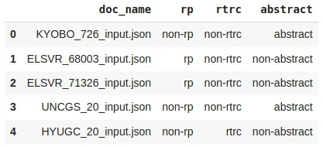
Adding Class weights and Converting Multiclass to Multilabel
Multi-Class to Multi-Label
Abstract : (non-rtrc,non-rp,abstract)
RTRC: (rtrc, non-rp, non-abstract)
RP: (non-rtrc, rp, non-abstract)
Class weights:
Giving more weight to rp over non-rp
​ | Accuracy​ | Precision​ |  |  |  | Infer Time (ms)​ | Feature Vec Size​
​ |  | Abstract​ | RTRC​ | RP​ | Others​
Before Adding​ | 92 | 1​ | 0.83​ | 1​ | -​ | 1.2​ | 1,41,364​
After Adding "Others"​ | 85 | 0.89​ | 0.95​ | 0.63​ | 0.83​ | 1.3​ | 1,67,507​
Removing Stopwords and increasing min_df​ | 85​ | 94​ | 90​ | 0.69​ | 0.90​ | 0.2​ | 823​
Adding Class weights and Multilabeling | 87 | 94 | 1 | 0.93 | 0.75 | 0.3 | 823

Slide 16
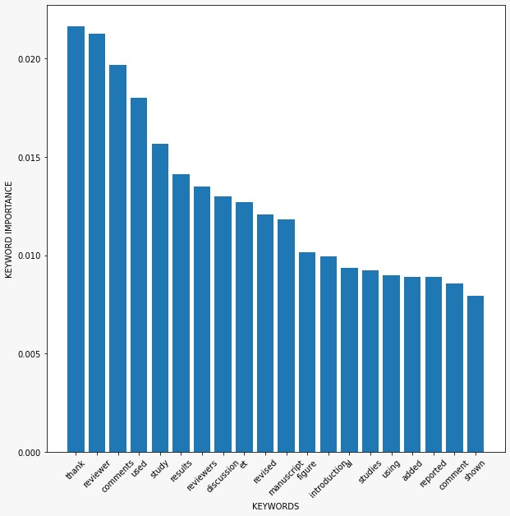
RF: Keyword Importance
Validating the keywords found in Rule-based classifiers

Slide 17
Other Experiments
Experiment | Hypotheses | Result
# paragraphs | There might be a trend and will capture layout features | Highly correlated with word count
Sentiment Analysis | docs like RTRC have high emotions | Mostly neutral tone for all MVP categories
MLP: Keras and Pytorch | Universal approximators | Acc: 88% , epoch time : 4s , params: 35M
POS Tags: | Documents have characteristic tense form of the verb. | Very Poor discriminating power.
Formatting Based features | Images and tables are largely in Research papers and Response to Reviewer Comments | Led to decrease in accuracy and precision.
# of headers | RP has the highest headers | Not a uniform distribution

Slide 18
Learnings…
About Cactus
Document parsing – docx + pdf
Working with Json files
Demo –AWS cloud + streamlit
ML + DL: deeper understanding
Code editor + terminal
Shell Scripting
Building Pipelines
Benchmarking Practices
Interpreting accuracy scores
Error analysis
Accountability and ownership

Slide 19
Further Scope..
Deploying it to Cactus Playground
De-noising the data further
Further hyper-parameter tuning and optimisation
More extensive testing on new datasets
Dry run and gathering feedback
Documentation and scripting

Slide 20
Demo

Slide 21

Thank You for listening
Questions ?

Slide 22
Metrics
Metric | Desirability
Accuracy | Maximum
F1 Score | Maximum
Vectorisation Time | Minimum
Inference Time | Minimum
Feature Vector Size | Minimum

Slide 23
Solution
Hyper Parameter Tuning
Data Preparation
Document Vectorisation
Model
Training and
Benchmarking
Model
Deployment
(Web Application)
Hypothesis testing

Slide 24
Solution
Data Preparation
Document Vectorisation
Model
Training and
Benchmarking
Model
Deployment
(Web Application)
Stopword and special character Removal
Lower Case
Stemming
Multiclass to MultiLabel
TFIDF Vectorisation
Minimum DF filter
Random Forest Classifier
Pruning
Regularisation(Max Depth)
Streamlit based Web Application

